Slide 1
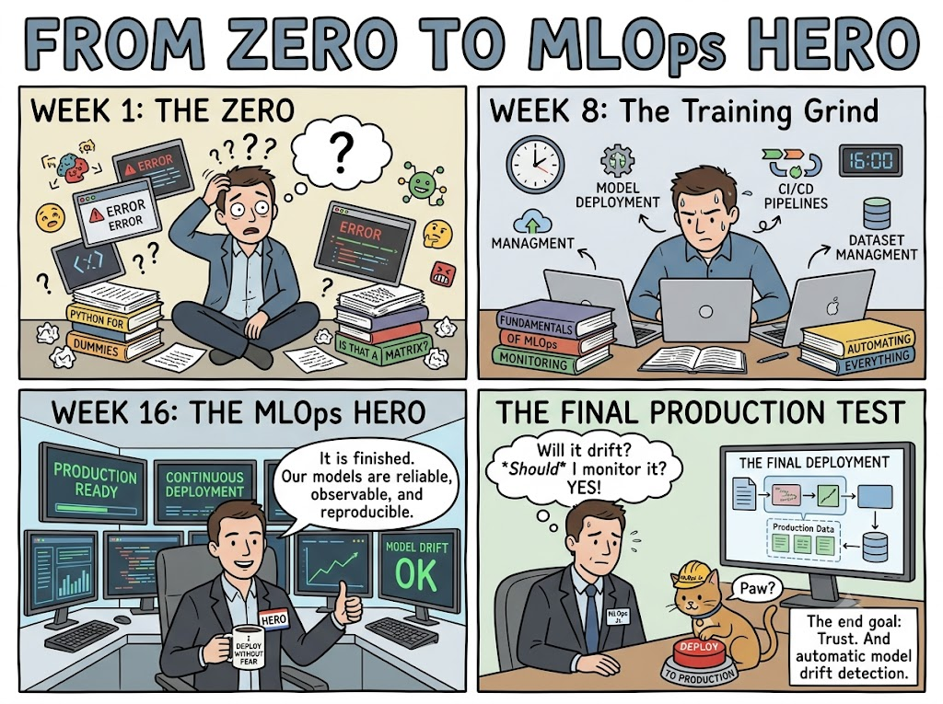
Your MLOps Learning Journey Begins Here!

Slide 2
Today's Agenda 📋
1. AWS Free Tier Setup (Cloud infrastructure)
2. Google Colab / Jupyter Notebook (Coding environment)
3. VS Code / IDE Setup (Code editor)
4. MLOps Interview Prep (Questions + System Design)
5. Portfolio Project Guide (High-level overview)
6. MLOps Q&A Session (Live discussion)

Slide 3
AWS Free Tier Setup ☁️
Step 1: Create Account
Go to aws.amazon.com → Create AWS Account
Step 2: Verify
Email verification + payment method (not charged)
Step 3: Enable Services
EC2, SageMaker, RDS, S3, Lambda (all free)
Step 4: Create IAM User
AWS Console → IAM → "AmazonSageMakerFullAccess"
Step 5: Generate Access Keys
Download CSV with Access Key ID + Secret

Slide 4
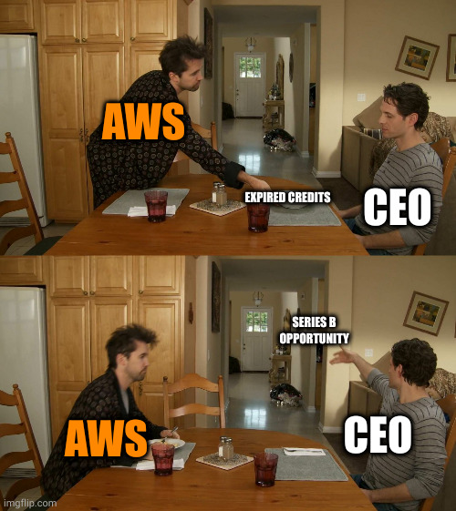
AWS Free Tier: What's Included 🎁
EC2 Instances
750 hours/month (t2.micro)
Run Ubuntu, training VMs
SageMaker
250 hours/month (free tier)
Full ML training & serving
S3 Storage
5 GB storage
Store datasets, models
RDS Database
750 hours/month (db.t2.micro)
MySQL, PostgreSQL
Lambda Functions
1 million invocations/month
Serverless ML pipelines
CloudWatch
Full monitoring
Track metrics, logs, alerts

Slide 5
Google Colab: Free Python Notebook 📓
What is Colab?
Free Jupyter notebook in browser (Google account needed)
Access
colab.research.google.com OR Google Drive → New → Colab
CPU/GPU Free
~12 hours free GPU per day (T4 GPU) + unlimited CPU
Pre-installed
Python 3.10+, TensorFlow, PyTorch, scikit-learn, pandas
Save
Auto-saves to Google Drive. Download as .ipynb anytime
No Setup
No install needed. Start coding immediately!

Slide 6
VS Code / IDE Setup 💻
Download
code.visualstudio.com → Download
Install
Run installer, add to PATH (allow shell access)
Extensions
Install: Python, Pylance, Jupyter, Docker, Git Graph
Python Setup
Select Python interpreter (3.10+) in VS Code
Virtual Env
python -m venv mlops_env → source activate
Git Integration
GitHub account → Clone repos → Push code
Debug Mode
F5 to debug, set breakpoints, inspect variables

Slide 7
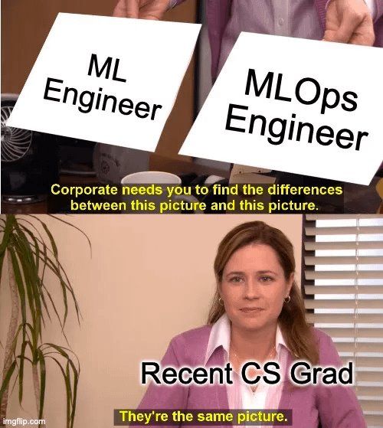
MLOps Interview Prep: Common Questions 🎤
Beginner-Level Questions (What you'll be asked)
Q1: What is MLOps? How is it different from ML Engineering?
Q2: Explain the ML lifecycle (data → train → deploy → monitor)
Q3: What is model drift? How do you detect & fix it?
Q4: Difference between CI/CD and ML Pipelines?
Q5: How do you version datasets? (DVC, Git LFS)
Q6: What is A/B testing? When would you use it?

Slide 8
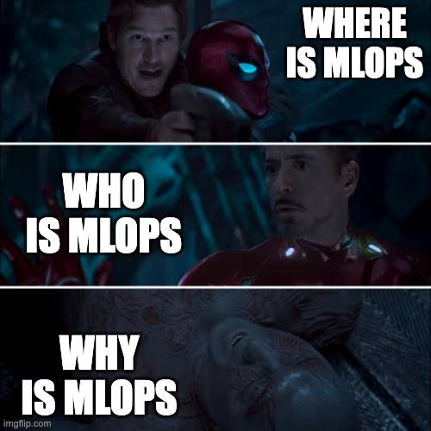
Interview Prep: Sample Answers 💡
How to Answer (Structure: What + Why + How)
Q: What is MLOps?
A: MLOps (ML Operations) is automating & managing the entire ML lifecycle -
from data collection to monitoring in production.
WHY: ML models fail silently. Data changes. Models degrade. MLOps ensures
models stay accurate, reliable, and scalable in production.
HOW: Use DVC (data versioning), Airflow (pipelines), MLflow (tracking),
Docker (deployment), Kubernetes (scaling), Prometheus (monitoring).

Slide 9
Interview Prep: System Design for MLOps 📐
Common Question: "Design an ML serving system"
Design Framework (Answer in 3 parts):
1. FUNCTIONAL REQUIREMENTS
• What should the system do? (predict on user requests)
• Throughput: 1000 predictions/sec | Latency: <100ms
2. TECHNICAL ARCHITECTURE
• Data: Kafka (streaming) + S3 (batch)
• Training: SageMaker + MLflow
• Serving: FastAPI + Docker + Kubernetes
• Monitoring: Prometheus + Grafana
3. TRADEOFFS & SCALING
• Batch vs real-time serving (latency vs cost)
• Model versioning (blue-green deployment)
• Failover & disaster recovery

Slide 10
Interview Prep: Coding Problem 💻
Problem: Build a simple ML prediction API
from flask import Flask, request, jsonify
import pickle
import numpy as np
app = Flask(__name__)
model = pickle.load(open('iris_model.pkl', 'rb'))
@app.route('/predict', methods=['POST'])
def predict():
data = request.json['features']
features = np.array(data).reshape(1, -1)
prediction = model.predict(features)[0]
return jsonify({'prediction': int(prediction)})
if __name__ == '__main__':
app.run(port=5000)
# Test:
# curl -X POST http://localhost:5000/predict \
# -H "Content-Type: application/json" \
# -d '{"features": [5.1, 3.5, 1.4, 0.2]}'

Slide 11
Portfolio Project Guide 📂
Why Portfolio Projects Matter
✓ Proves you can build end-to-end ML systems
✓ Shows production thinking: monitoring, versioning, documentation
✓ Hiring managers want to see: Code quality, system design, communication
✓ Differentiates you from 10,000 freshers applying
✓ LinkedIn + GitHub visibility = Direct inbound job offers

Slide 12
Portfolio Project: What to Build 🛠️
Project 1: Data Pipeline (DVC + Airflow)
Automate data ingestion, cleaning, versioning
Project 2: ML Serving API (FastAPI + Docker)
Deploy model, expose REST API, containerize
Project 3: Full MLOps System (End-to-end)
Data → Train → Serve → Monitor (Prometheus)
⭐ Detailed breakdown: Sessions 1-10 will cover each project step-by-step

Slide 13
MLOps Q&A: Quick Concepts 🎯
Key Concepts You'll Encounter (Freshers FAQ)
DVC
Data Version Control - Track data changes like Git
MLflow
Experiment tracking + model registry + serving
Kubernetes
Container orchestration - scale models to servers
Docker
Containerization - package code + dependencies
Prometheus
Monitoring - track model performance in production
Model Drift
When model accuracy drops due to data changes
Feature Store
Centralized repo of features for training & serving
Experiment Tracking
Log params, metrics, artifacts to compare runs

Slide 14
Handout & Reference Guide 📚
What You'll Get After This Class
Complete Setup Guide
Step-by-step AWS, Colab, VS Code setup
MLOps Glossary (PDF)
Quick reference: DVC, MLflow, Kubernetes, etc.
Interview QA Document
50+ MLOps interview questions with answers
Code Templates
Flask API, Airflow DAG, MLflow tracking examples
Resource Links
Curated tutorials, documentation, learning paths
Portfolio Project Templates
GitHub repo with starter code for all 3 projects

Slide 15
Anticipated Q&A 💬
Questions Freshers Ask (With Answers)
Q: Do I need GPU for learning MLOps?
A: No. Free Colab GPU is enough. AWS handles scaling.
Q: Can I skip AWS and just use Colab?
A: Not recommended. Learn both for complete picture.
Q: How long to master MLOps?
A: 6-12 months hands-on practice. Depth comes with experience.
Q: Which framework should I focus on?
A: Start scikit-learn, then TensorFlow (industry popular).

Slide 16
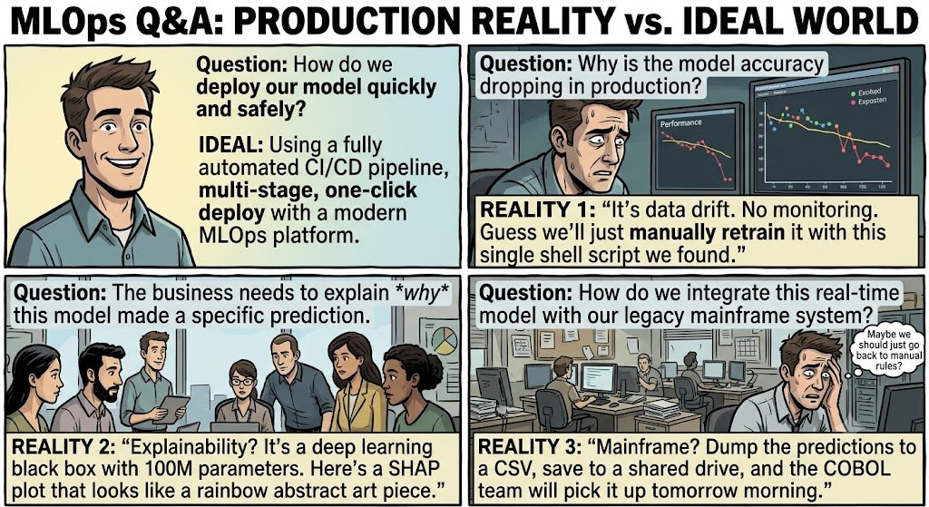
More Q&A 💬
Q: What's the difference between MLOps and DevOps?
A: DevOps: automate software. MLOps: automate ML models.
Q: Do I need Kubernetes to start?
A: No. Learn Docker first. K8s comes later (optional).
Q: How to stand out among 10,000 applicants?
A: GitHub projects + blog posts + conference talks.
Q: Will the industry accept me without a degree?
A: Yes. Skills > degree. Portfolio + experience = highest value.
Q: Should I pursue specialization early?
A: No. Build breadth first. Specialize after 2-3 years.

Slide 17
Resources & Learning Links 🔗
AWS
aws.amazon.com/free
Google Colab
colab.research.google.com
VS Code
code.visualstudio.com
MLflow Docs
mlflow.org
DVC Docs
dvc.org
Kubernetes
kubernetes.io/docs
FastAPI
fastapi.tiangolo.com
GitHub
github.com

Slide 18

Need more ?.

Slide 19
Resume Building for MLOps Freshers 📄
What Hiring Managers Look For (In This Order)
1. Portfolio Projects
GitHub links to 3-4 end-to-end ML projects [MUST HAVE]
2. Technical Skills
DVC, MLflow, Docker, K8s, FastAPI, Airflow [CRITICAL]
3. Impact Metrics
"Deployed model serving 1M predictions/day" [IMPORTANT]
4. Education
Degree + certifications (AWS, GCP, CKA optional) [NICE TO HAVE]
5. Open Source
Contributions to MLflow, Ray, Airflow repos [DIFFERENTIATOR]
6. Blog/Speaking
Technical blog posts or conference talks [STANDOUT]

Slide 20
Resume Template for MLOps Freshers 📋
HEADER: Name | Email | Phone | LinkedIn | GitHub
SUMMARY (2-3 lines):
"MLOps engineer building & deploying production ML systems.
Skilled in DVC, Docker, Kubernetes, MLflow."
TECHNICAL SKILLS
• Data & Versioning: DVC, SQL, Pandas, Git
• Frameworks: scikit-learn, TensorFlow, PyTorch
• Deployment: Docker, Kubernetes, Airflow, FastAPI
• Tools: MLflow, AWS SageMaker, Prometheus
PROJECTS (GitHub links - YOUR POWER!)
1. Data Pipeline Automation (DVC + Airflow)
Automated data ingestion & cleaning for 50GB dataset
GitHub: [link] | Reduced manual work by 80%
2. ML Model API (FastAPI + Docker + K8s)
Production REST API for classification model
Serves 100+ requests/day with <100ms latency
GitHub: [link] | Live API: [endpoint]
3. Full MLOps System (End-to-end)
Data → Training → Serving → Monitoring
GitHub: [link] with architecture diagrams
EXPERIENCE / INTERNSHIP
• Reduced model deployment time from 2 days to 2 hours
• Built monitoring dashboard catching 95% model drift
CERTIFICATIONS (Optional)
AWS Certified Solutions Architect / Kubernetes CKA
EDUCATION
Bachelor's in CS/IT from [University]
DO'S ✓: Keep to 1 page | Lead with projects | Use action verbs
DON'Ts ✗: Don't lie | Don't skip GitHub links | Don't be vague

Slide 21
LinkedIn Profile Optimization 🎯
Get Recruiter Attention
Profile Photo
Professional headshot (smiling, clear)
[Critical]
Headline
"MLOps Engineer | Building Production ML Systems"
[Critical]
About Section
3-4 sentences about MLOps focus + GitHub link
[Important]
Experience
Add projects as "Experience" with descriptions
[Important]
Skills
Add: DVC, Docker, K8s, MLflow, Airflow, FastAPI
[Important]
Open to Work
Turn ON badge for recruiter visibility
[Critical]
Post & Engage
Share learnings weekly → visibility
[Differentiator]

Slide 22
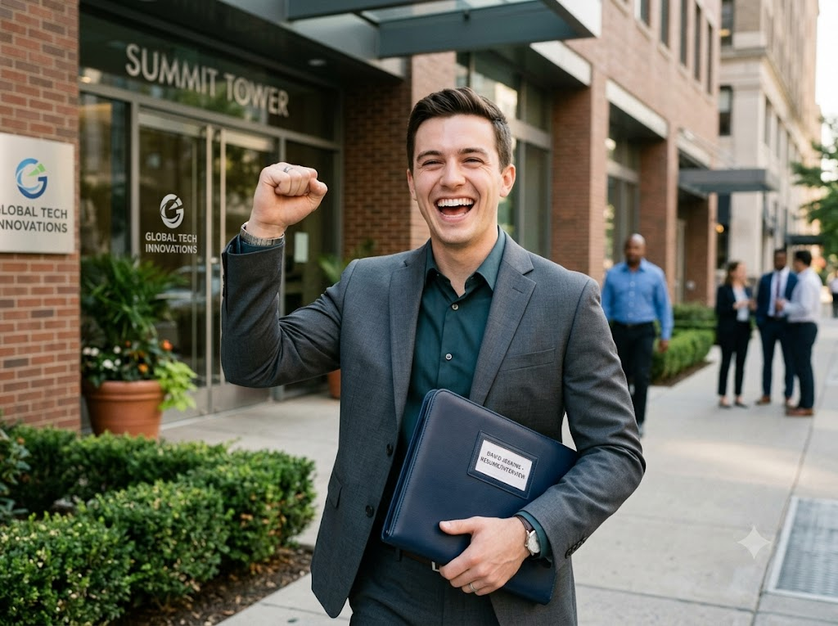
How to Nail the Interview 💪
✓ Use STAR method: Situation → Task → Action → Result
✓ Prepare 3-4 stories about your projects (use in every answer)
✓ In technical rounds: Think out loud, explain your approach
✓ Ask good questions: "How do you handle model drift?"
✓ Send thank-you email within 2 hours (mention specifics)
✓ Practice LeetCode/HackerRank (Medium level questions)
✓ For system design: Draw architecture, discuss tradeoffs

Slide 23
Interview Prep Timeline 📅
From Resume Submission to Job Offer (4-Week Timeline)
Day 1
Submit resume on LinkedIn, job boards, company website
Day 1-3
Recruiter screens resume (60-90 sec) → Call if interested
Day 3-7
Phone screening (30 min) → Technical Q&A about projects
Day 7-14
Technical interview (60-90 min) → Coding + system design
Day 14-21
Onsite/Video rounds (2-3 rounds) → Meet the team
Day 21-28
Offer negotiation → Salary, benefits, joining date

Slide 24
Ready to Transform Your Career? 🚀
Start Today. 16 Weeks. Production-Ready Skills.
Let's Build Together!

